Slide 1
Rosacea Classification Using Deep Stacking Multi-Layer Model (DSMLM)
Paper ID:
Dr. Antony Sophia N, Assistant Professor
Dr.T R Saravanan, Associate Professor
Department of Computational Intelligence , SRM Institute of Science and Technology , Chennai
Ms. Vigneshwari M, Assistant Professor,
Department of Information Technology, Vel Tech Multi Tech Dr.Rangarajan Dr.Sakunthala Engineering College
Ms.Deepika N, Assistant Professor, , Department of Computer science and engineering,
Sri Venkateswara College of Engineering
Dr. K.Uma, Associate Professor, Madhavan P, UG Student,
School of Computer Science Engineering and Information System
Vellore institute of technology.

Slide 2
Abstract
Rosacea, a widespread and complex skin disorder affecting most of the world population, is divided into various subtypes with unique clinical features the complexity of these subtypes makes accurate classification difficult. A unique technique called the Deep Stacking Multi-Layer Model (DSMLM) has been proposed as a solution for this complex classification. To extract microelements from clinical images and patient history data, DSMLM uses a multilayered neural network architecture. Using the stacking ensemble strategy to combine predictions from different base models makes it possible to improve the classification performance. The effectiveness of the DSMLM is evaluated using a large dataset of different rose cases, and it shows remarkable accuracy in distinguishing between different rose subtypes

Slide 3
Introduction
Rosacea, a prevalent chronic skin disorder affecting 5-10% of the global population, presents diagnostic challenges due to its diverse subtypes and complex clinical manifestations.
Characterized by facial redness, visible blood vessels, and various skin irregularities, accurate diagnosis is hindered by the need to distinguish between subtypes, demanding a deeper understanding of its pathophysiology.
This study addresses the diagnostic complexity by introducing the Deep Stacking Multi-Layer Model (DSMLM), leveraging machine learning and deep learning techniques.
DSMLM aims to enhance rosacea subtype classification accuracy by combining multiple base models through stacking, utilizing a multi-layer neural network architecture for feature extraction from clinical images and patient history data.

Slide 4
Literature Review
Author | Title & Year | Method Used | Limitations
Liu, F. T., et al. | Skin disease recognition using deep convolutional neural network and data augmentation (2019) | Deep convolutional neural networks (CNNs) for skin disease recognition, leveraging the network's ability to automatically learn hierarchical features from images. | It is challenging to evaluate the reliability and effectiveness of these models in accurately categorizing Rosacea subtypes.
Bao, S., et al. | Ensemble of deep convolutional neural networks for classification of colorectal cancer images (2020) | Combines multiple deep convolutional neural networks (CNNs) for the classification of colorectal cancer images | Limitation raises concerns about the models' applicability to a wide range of real-world cases and varying manifestations of Rosacea.
Wang, L., et al. | Deep stacking networks for classification of skin cancer (2020) | Integrates deep learning models, including convolutional neural networks (CNNs) | Standalone CNNs not enough for the classification of skin cancer
Yin, X., et al. | A deep stacking model for the early detection of diabetic retinopathy (2021) | XGB-Stacking model with the foundation of XGBoost and stacking was used for a wrapped feature selection al XGBIBS (Improved Backward Search Based on XGBoost), was used to reduce data feature redundancy and improve the effect of a single ensemble learning classifier. | Potential limitations could include the dependence on the effectiveness of XGBoost as the foundational model

Slide 5
Literature Review
Author | Title & Year | Method Used | Limitations
Yousef, S., et al. | A hybrid deep learning model for skin lesion classification (2021) | K-means with GOA-based segmentation, SURF-based feature extraction, and SURF-based feature extraction are the five steps of the described model's operation and feature selection using GOA and CNN-based training as well as classification. | The integration of multiple steps, including preprocessing, segmentation, feature extraction, and CNN-based training, could result in a complex algorithm. Managing and optimizing such complexity may pose challenges in terms of computational efficiency and resource requirements.
Singh, S., et al. | Deep learning-based skin disease classification for real-time telemedicine applications (2021) | The proposed approach involves multiple stages, including contrast enhancement, custom CNN architecture, transfer learning with multiple pre-trained models, fusion techniques, and feature selection. | Complexity in increased computational demands, potentially limiting its applicability in resource-constrained environments.
Tabesh, A., et al. | Ensemble deep learning for skin lesion classification (2021) | Color Normalization, Morphological Filtering, Data Augmentation: Techniques and Transfer Learning was used to Fine-tuned CNN models, including the Swin-Transformer and EfficientNetV2S, leveraging pre-existing knowledge. | The multi-stage process, especially with complex models like Swin-Transformer, might demand significant computational resources. The intricate model stages, especially after fusion and selection, may reduce interpretability, making it challenging to understand the specific contributions of each component.

Slide 6
Objective
The primary goal is to develop a robust model, Deep Stacking Multi-Layer Model (DSMLM), capable of accurately categorizing various Rosacea subtypes, including erythematotelangiectatic, papulopustular, phymatous, and ocular Rosacea.
The model aims to apply its learned information to effectively categorize previously unidentified or novel cases of Rosacea subtypes, ensuring real-world applicability in clinical practice.
Given the diverse indications of Rosacea across individuals and even within the same subtype, the DSMLM is designed to handle variability, providing precise and reliable predictions.

Slide 7
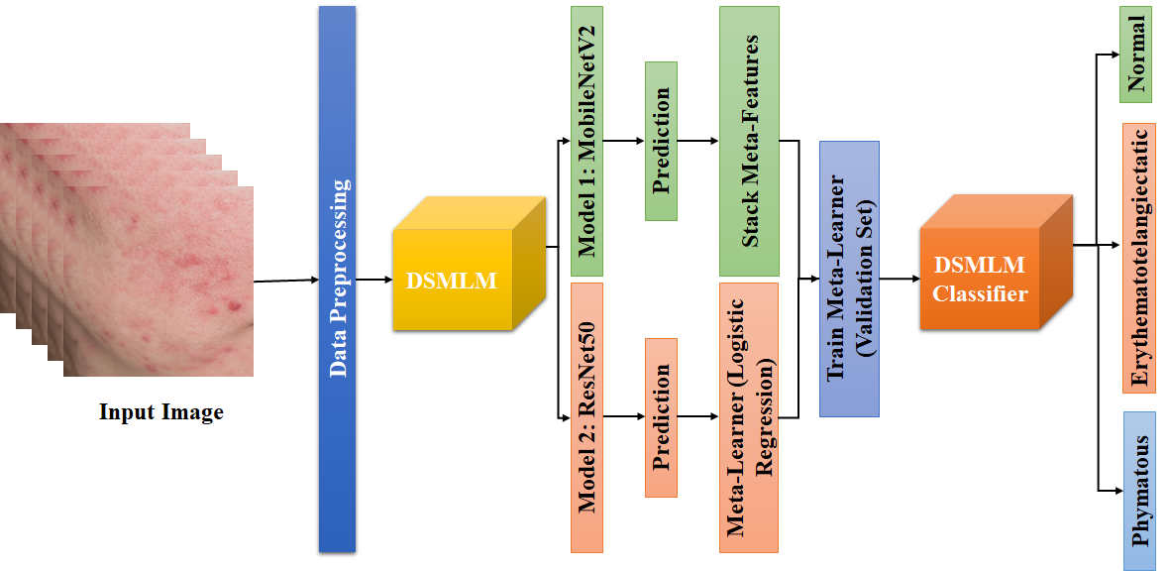
Architecture Diagram

Slide 8
Proposed System
Input Collection: The process begins with collecting skin images, including various skin diseases, from the ISIC archive, forming the input dataset for Rosacea classification.
Data Preprocessing: Images undergo preprocessing to ensure uniform size and scale. Techniques such as scaling, normalizing, and data augmentation, involving rotations, flips, and adjustments, are applied to enhance model generalization.
Base Models: Multiple base models, including MobileNetV2 and ResNet50 pretrained on datasets like ImageNet, analyze preprocessed images, capturing essential features related to erythematotelangiectatic Rosacea subtypes.
Base Model Predictions: Each base model produces predictions indicating the likelihood of input images belonging to different categories, including normal, papulopustular, and phymatous rosacea subtypes.
Stack Meta-Features (Input): Predictions from base models are aggregated and stacked, generating meta-features for each input image. These meta-features serve as input for subsequent stages.
Meta Learner (Logistic Regression): Stacked meta-features are fed into a meta-learner, employing Logistic Regression as a classifier. The meta-learner aims to integrate predictions from base models and make a final classification determination.
Training and Evaluation: The meta-learner is trained on a labeled dataset with known ground truth labels, using an evaluation set for training. The validation set, comprising images not used in base models' training, aids in determining optimal weights for each base model's predictions, ensuring precise final predictions.

Slide 9
DSMLM
The Deep Stacking Multi-Layer Model (DSMLM) is designed for precise classification of Rosacea subtypes in skin scans, emphasizing accuracy and reliability through meticulous coordination of preprocessing and feature extraction techniques.
Input Processing: Beginning with an input skin image, the DSMLM employs various techniques such as quadrant swapping, CLAHE, color directionality analysis, and color-based segmentation to extract relevant information, ensuring uniformity and enhancing classification accuracy.
Quadrant Swapping: Quadrant swapping corrects artifacts caused by differences in image capturing, ensuring consistent processing. Mathematical representation involves altering pixel values within the image to promote uniformity.
CLAHE Preprocessing: Contrast Limited Adaptive Histogram Equalization (CLAHE) enhances visibility of small details in skin images by rearranging pixel intensity levels to increase contrast, aiding in the extraction of fine details for improved classification.
Color Directionality Analysis: Color directionality analysis employs Gabor filters to examine directional characteristics of color, providing essential information about skin structure and texture, contributing to the understanding of underlying skin properties.
Color-Based Segmentation: Color-based segmentation techniques like k-means clustering utilize color information to divide images into groups or areas, employing Euclidean distance for pixel assignment, initialization, assignment, and updating cluster centers.
Principal Component Analysis (PCA) and RATS: Karhunen-Loève Transform (KLT), captures data variability using principal components, while RATS (Robust Automatic Threshold Selection) ensures adaptive thresholding for binarizing images, making DSMLM adaptable to various image situations and enhancing performance in challenging scenarios.

Slide 10
DSMLM Classifier
Apply logistic regression as the meta-learner to process the stacked meta-features. The meta-learner combines predictions from base models, weighing each model's contribution to make a final, precise classification determination.
Train the logistic regression meta-learner using a labeled dataset with known ground truth labels, incorporating an evaluation set for training. The validation set, containing images not used in base models' training, helps determine optimal weights for each base model's predictions.
The DSMLM classifier produces final predictions for each input image, accurately categorizing it into Erythematotelangiectatic Rosacea, Normal, Papulopustular Rosacea, or Phymatous Rosacea based on the weighted contributions of the base models.

Slide 11
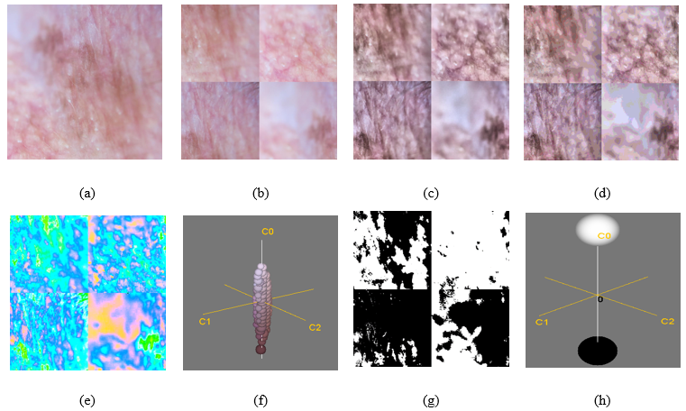
Results and Discussion
Input Image
(b) Swap Quadrants
(c) CLAHE
(d) Directionality of color
(e) Color Segment
(f) KLT/PCA of color Segmentation
(g) RATS
(h) KLT/PCA of RATS

Slide 12
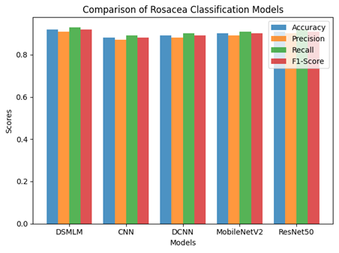
Performance Analysis
Model | Accuracy | Precision | Recall | F1-Score
DSMLM with Logistic Regression | 0.92 | 0.91 | 0.93 | 0.92
CNN | 0.88 | 0.87 | 0.89 | 0.88
DCNN | 0.89 | 0.88 | 0.90 | 0.89
MobileNetV2 | 0.90 | 0.89 | 0.91 | 0.90
ResNet50 | 0.91 | 0.90 | 0.92 | 0.91

Slide 13
Conclusion
The DSMLM, a Rosacea classification model, consistently performs better than others, achieving high accuracy, precision, recall, and F1-score.
Opportunities for improvement include using larger datasets and exploring advanced techniques.
Enhancing DSMLM's efficiency for real-time diagnosis is crucial for practical use.
Collaboration between dermatologists and data scientists is essential for refining and optimizing the model.
The success of DSMLM opens the door for ongoing advancements in dermatological diagnostics, promising better precision and efficiency for patient care.

Slide 14
References
Liu, F. T., et al. (2019). Skin disease recognition using deep convolutional neural network and data augmentation. Computers in Biology and Medicine, 109, 1-7.
Bao, S., et al. (2020). Ensemble of deep convolutional neural networks for classification of colorectal cancer images. Journal of Healthcare Engineering, 2020.
Li, Z., et al. (2019). An ensemble model of convolutional neural networks improves the diagnostic accuracy of idiopathic pulmonary fibrosis. Computers in Biology and Medicine, 109, 101-110.
Wang, L., et al. (2020). Deep stacking networks for classification of skin cancer. IEEE Transactions on Neural Networks and Learning Systems.
Zhang, B., Zhou, X., Luo, Y., Zhang, H., Yang, H., Ma, J., & Ma, L. (2021). Opportunities and challenges: Classification of skin disease based on deep learning. Chinese Journal of Mechanical Engineering, 34(1), 1-14.
Rehman, A., Naz, S., & Razzak, I. (2022). Leveraging big data analytics in healthcare enhancement: trends, challenges and opportunities. Multimedia Systems, 28(4), 1339-1371.

Slide 15
References
Hang, W, et al. (2023). Deep stacked least square support matrix machine with adaptive multi-layer transfer for EEG classification. Biomedical Signal Processing and Control, 82, 104579.
Pacal, I., & Kılıcarslan, S. (2023). Deep learning-based approaches for robust classification of cervical cancer. Neural Computing and Applications, 1-16.
Sarvamangala, D. R., & Kulkarni, R. V. (2022). Convolutional neural networks in medical image understanding: a survey. Evolutionary intelligence, 15(1), 1-22.
Navarini, A. A., Kolm, I., & Pennington, D. J. (2015). The age‐old problem of acne. Clinical and Experimental Dermatology, 40(7), 711-711.
Pielaszkiewicz, L., Krawczyk, B., & Rybarczyk, A. (2018). Skin lesion classification based on ensemble of deep models and majority class-aware balancing. Biomedical Engineering Online, 17(1), 1-19.
Schomacker, K., Wong, J. J., & Shaheen, K. Y. (2019). A machine learning-based approach to dermatologic diagnosis. Radiology: Artificial Intelligence, 1(1), e180048.
Tan, J., Almazan, T. H., & Sobrepeña, L. M. (2019). Skin lesion analysis for skin cancer detection. Journal of King Saud University-Computer and Information Sciences.

Slide 16
THANK YOU

